Slide 1
Symbolic execution

Slide 2
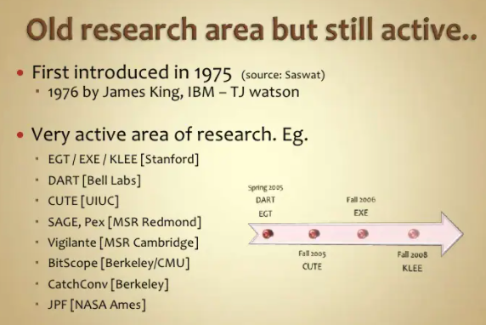
symbolic execution?

Slide 3
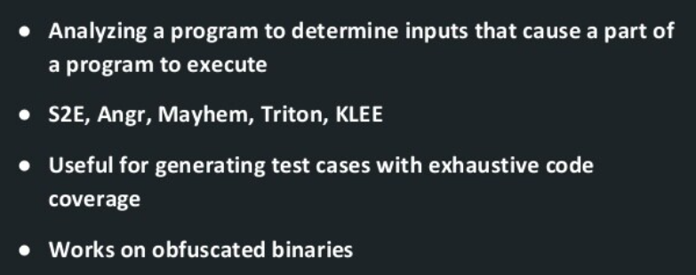
symbolic execution? WHY?

Slide 4
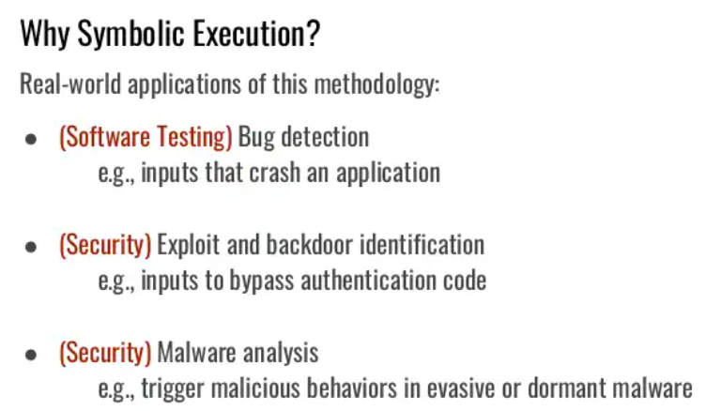
https://www.slideshare.net/EmilioCoppa/symbolic-execution

Slide 5
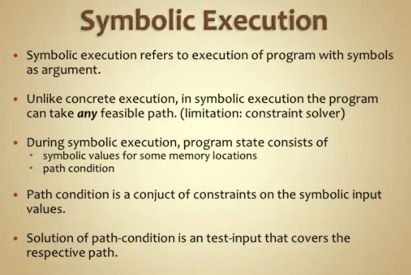
symbolic execution?

Slide 6
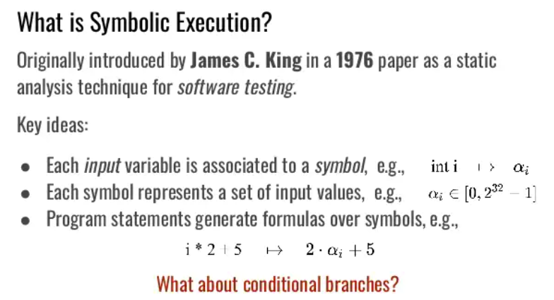
https://www.slideshare.net/EmilioCoppa/symbolic-execution

Slide 7
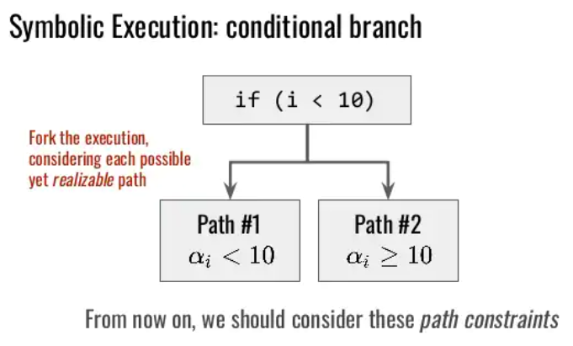

Slide 8
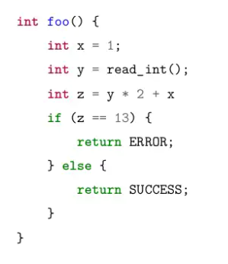
https://www.slideshare.net/FabioRosato/symbolic-execution-of-malicious-software-countering-sandbox-evasion-techniques

Slide 9
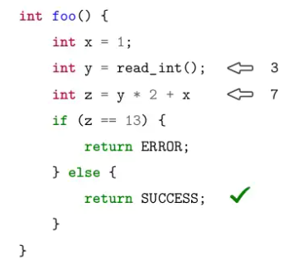
https://www.slideshare.net/FabioRosato/symbolic-execution-of-malicious-software-countering-sandbox-evasion-techniques

Slide 10
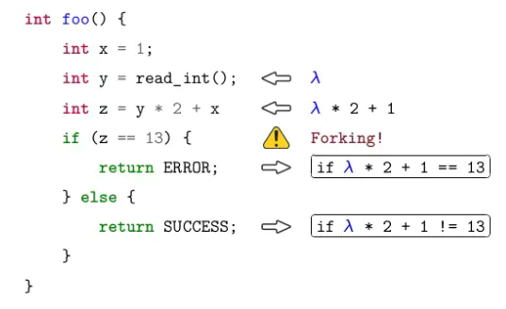
https://www.slideshare.net/FabioRosato/symbolic-execution-of-malicious-software-countering-sandbox-evasion-techniques

Slide 11
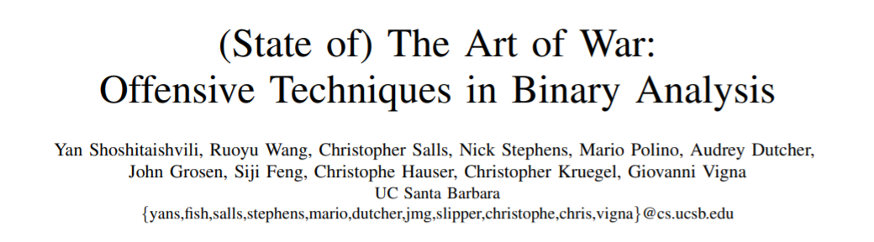

Slide 12
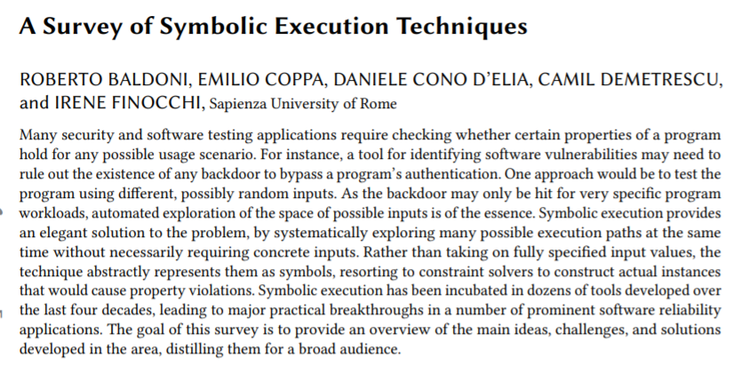
https://arxiv.org/pdf/1610.00502.pdf

Slide 13
Z3

Slide 14
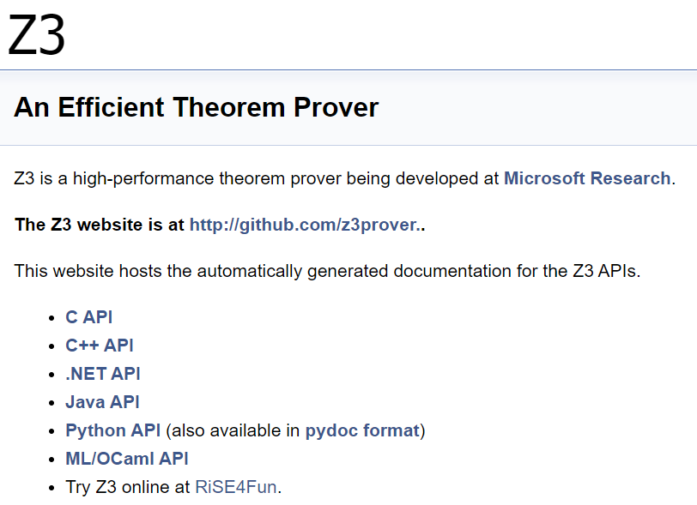

Slide 15
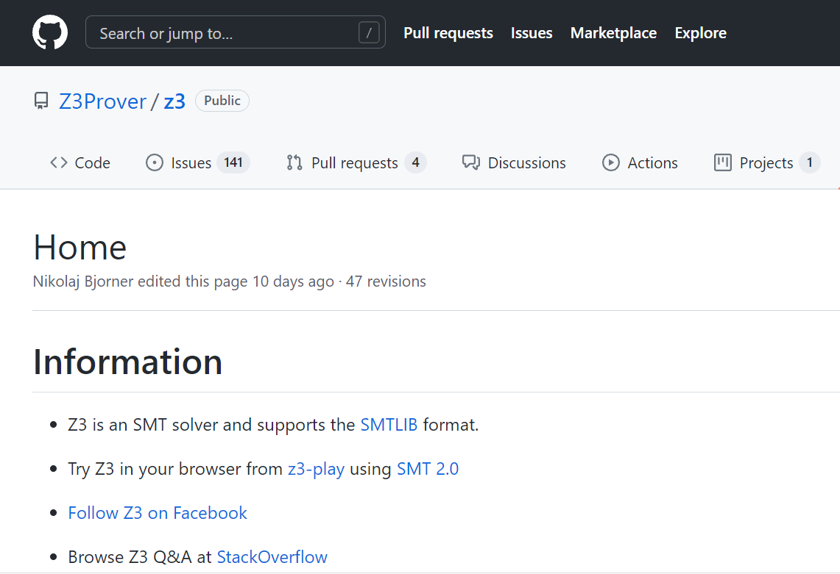
https://github.com/Z3Prover/z3/wiki

Slide 16
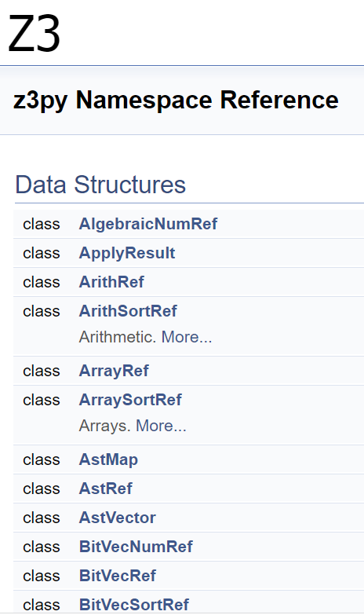
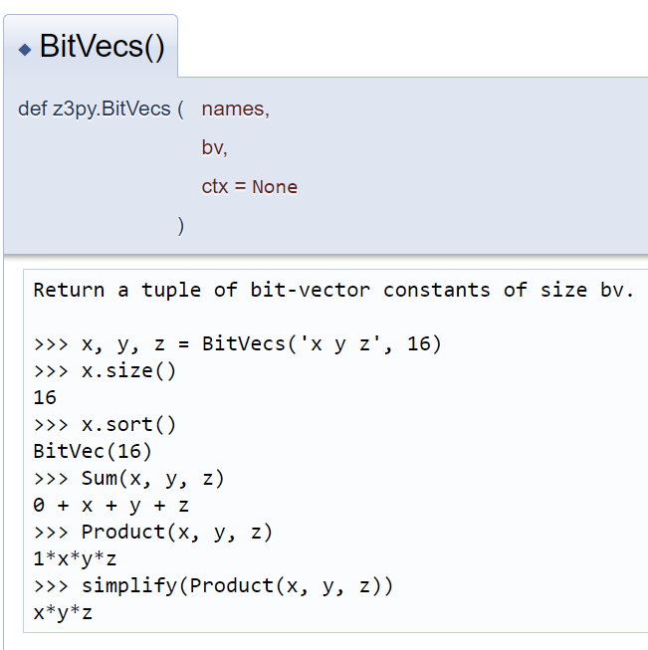
https://z3prover.github.io/api/html/namespacez3py.html

Slide 17
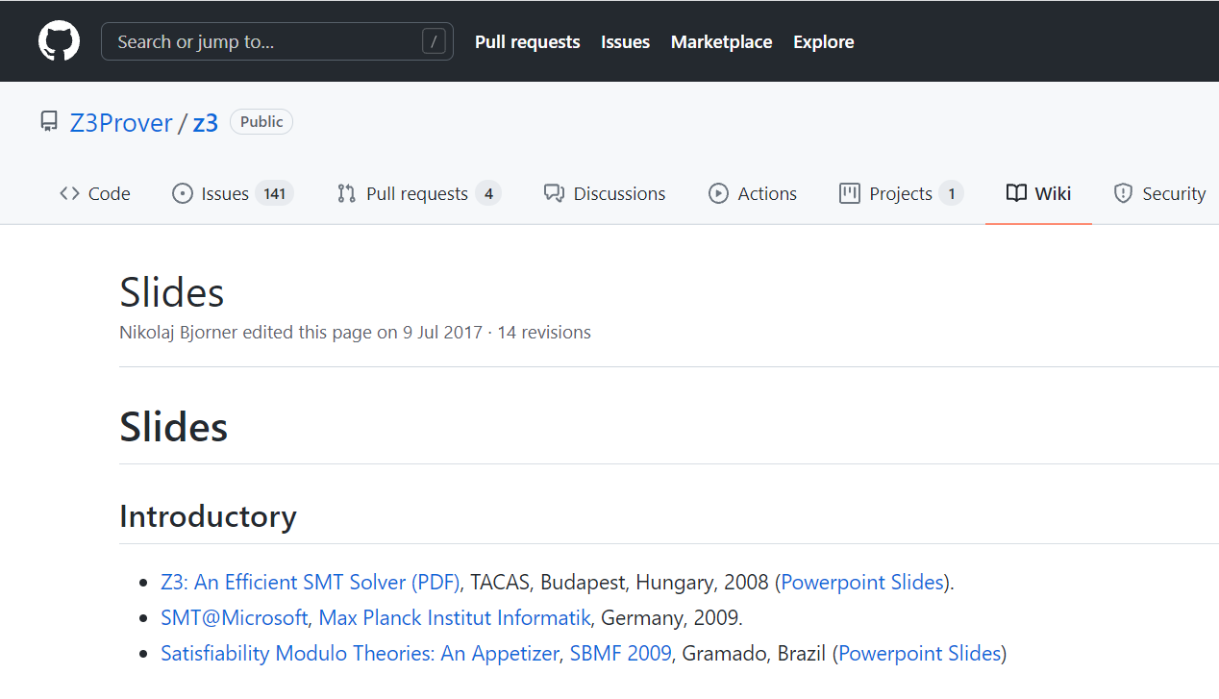
https://github.com/Z3Prover/z3/wiki/Slides

Slide 18
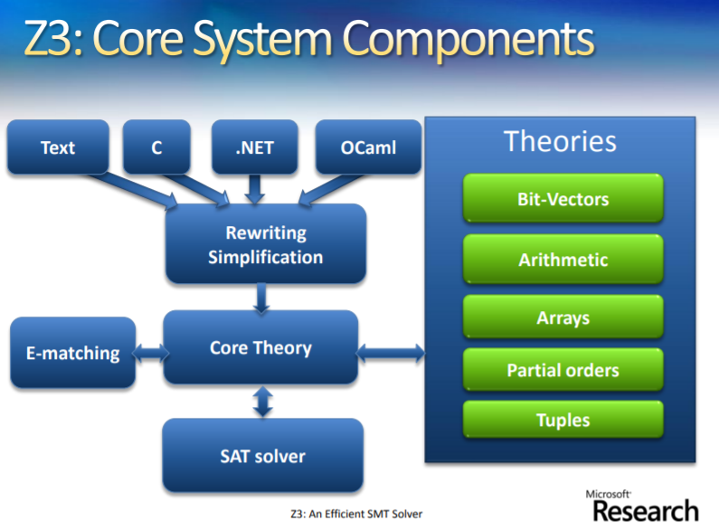
https://nikolajbjorner.github.io/slides/Z3_System.pdf

Slide 19
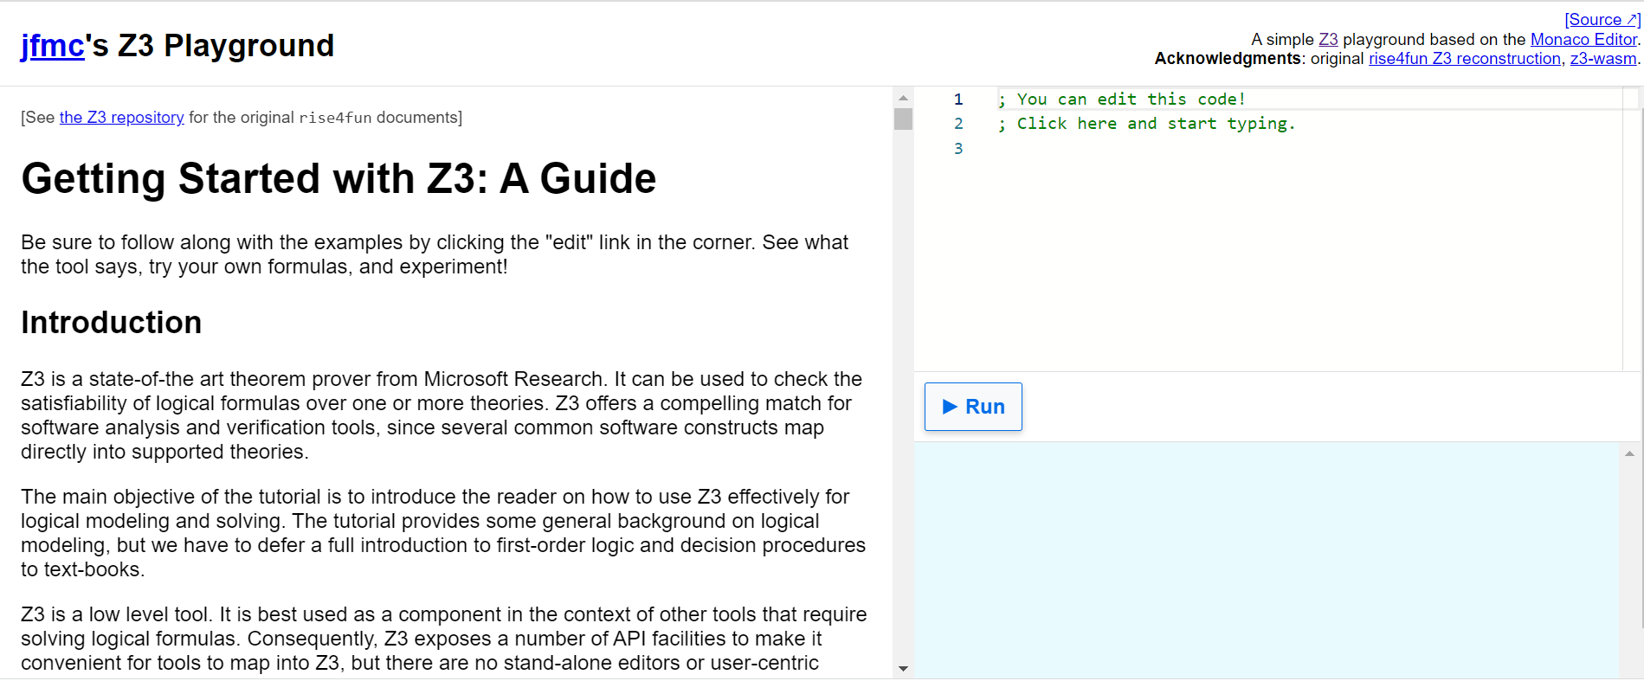
https://jfmc.github.io/z3-play/

Slide 20
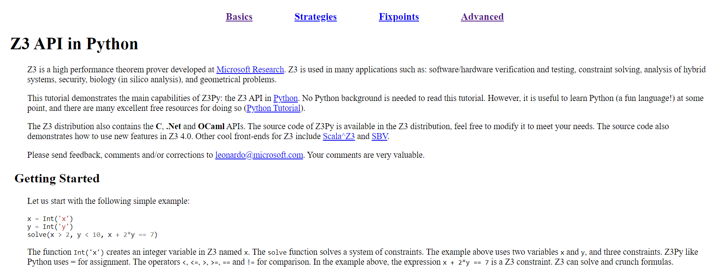
http://ericpony.github.io/z3py-tutorial/guide-examples.htm

Slide 21
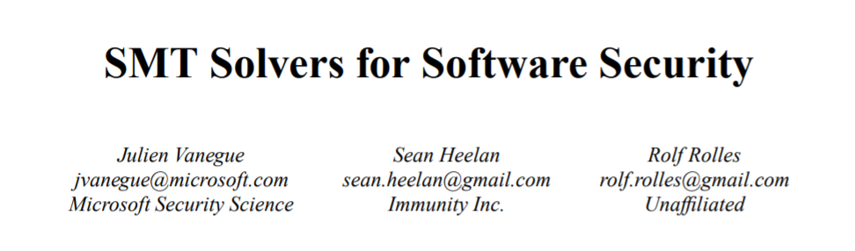
https://openwall.info/wiki/_media/people/jvanegue/files/woot12.pdf

Slide 22
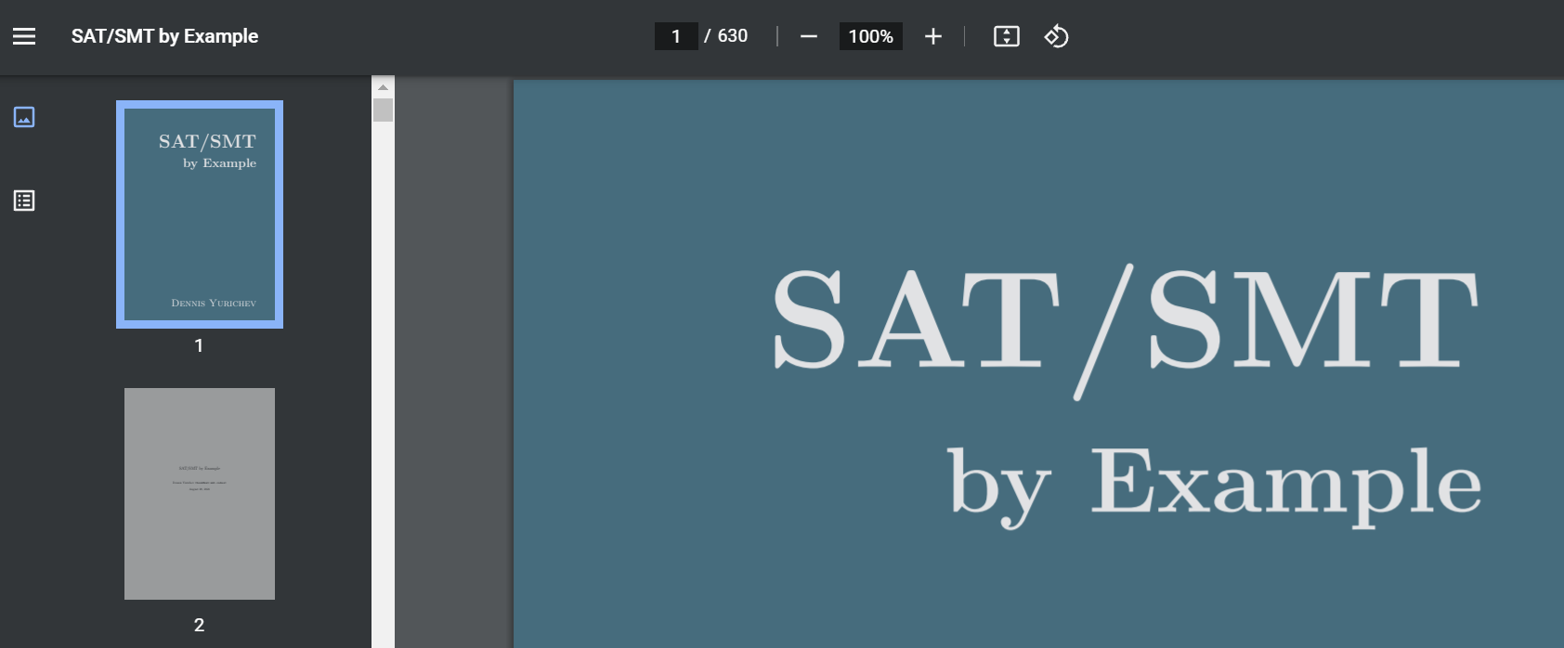
https://sat-smt.codes/SAT_SMT_by_example.pdf

Slide 23
Angr

Slide 24
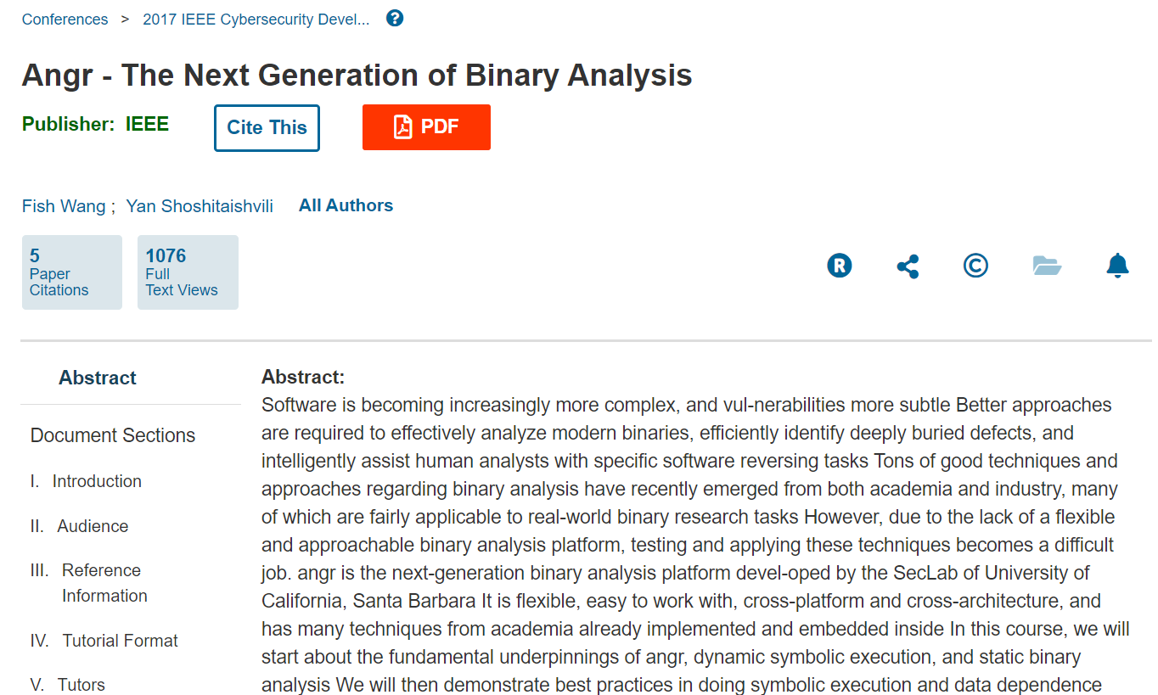
Angr

Slide 25
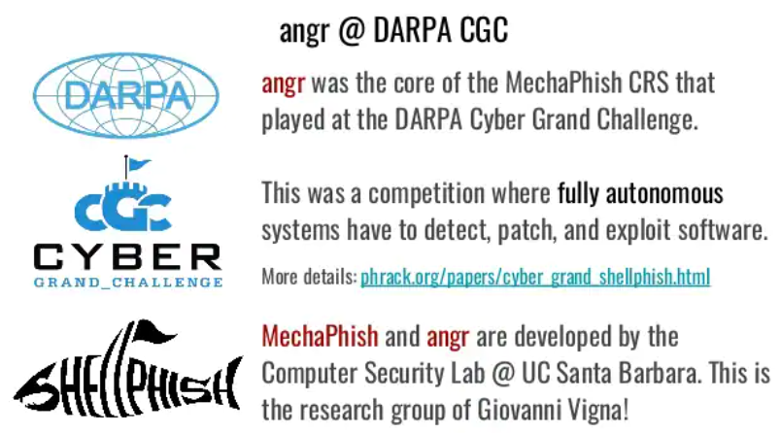
https://www.slideshare.net/EmilioCoppa/symbolic-execution

Slide 26
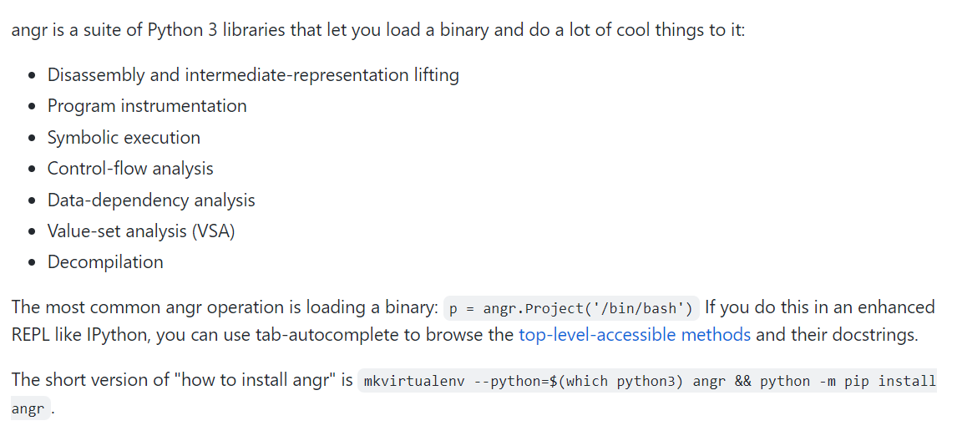
https://github.com/angr/angr

Slide 27
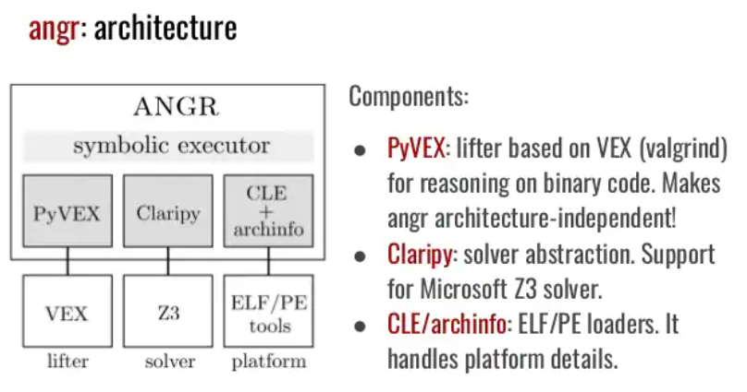
https://www.slideshare.net/EmilioCoppa/symbolic-execution

Slide 28
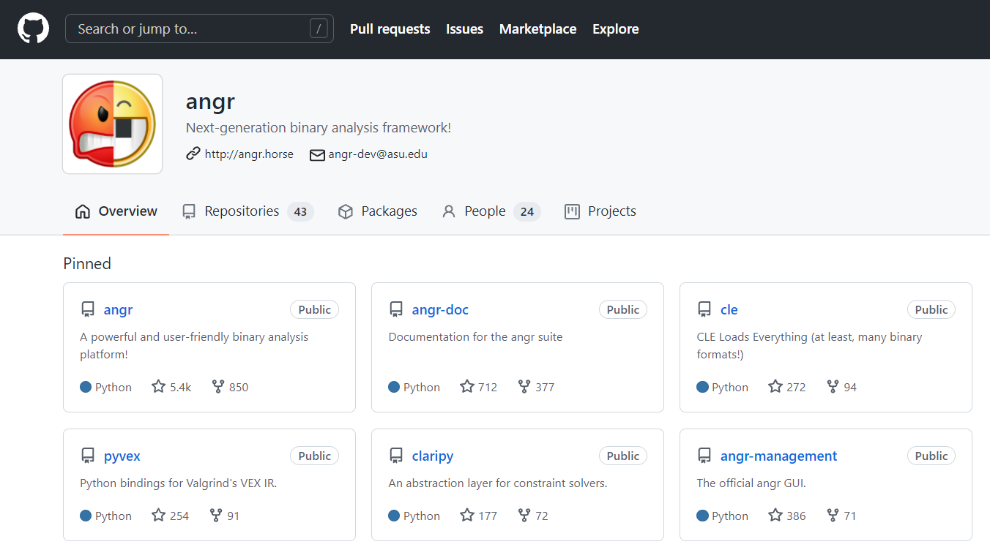
https://github.com/angr

Slide 29
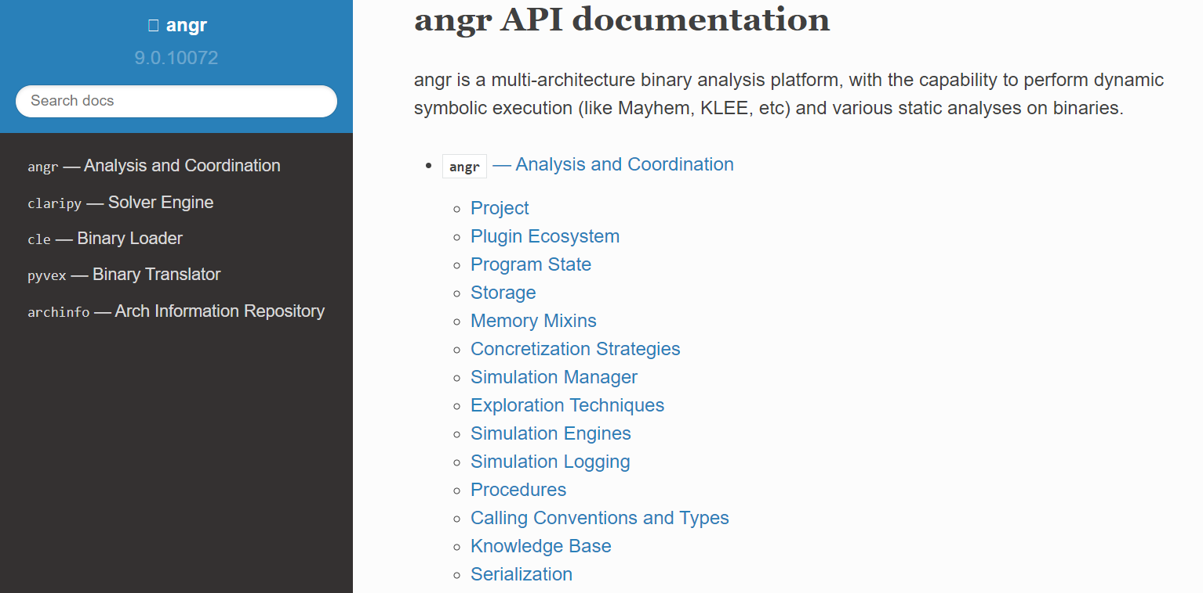
http://angr.io/api-doc/

Slide 30
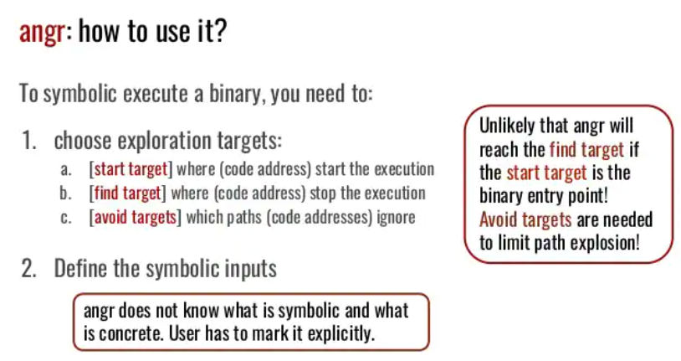
https://www.slideshare.net/EmilioCoppa/symbolic-execution

Slide 31
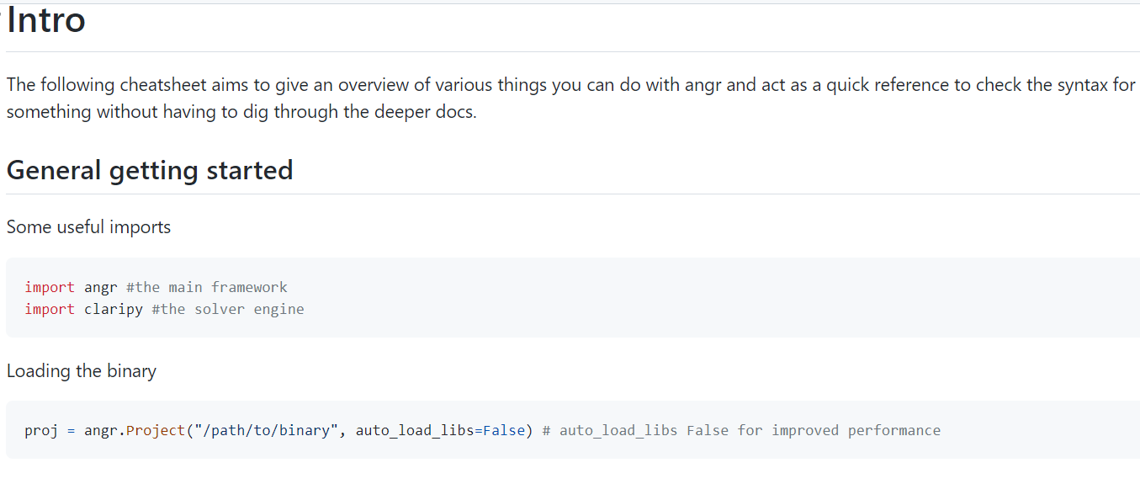
https://github.com/angr/angr-doc/blob/master/CHEATSHEET.md

Slide 32
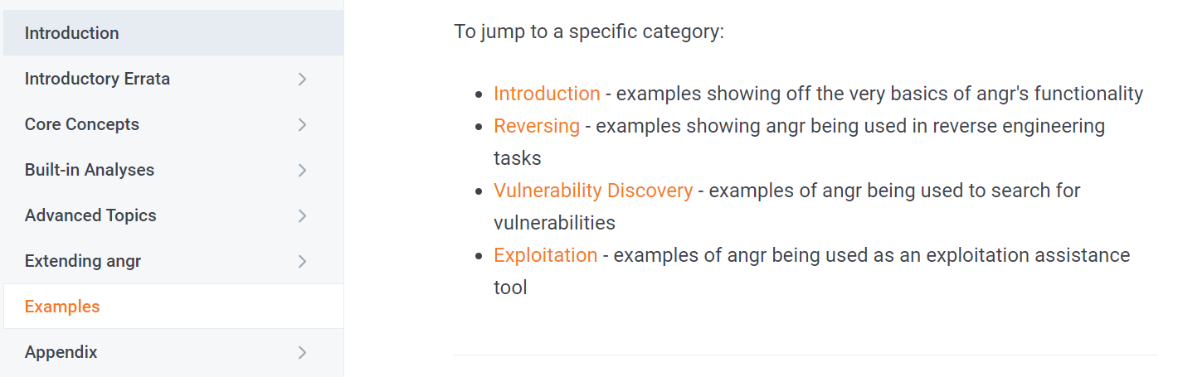
https://docs.angr.io/examples

Slide 33
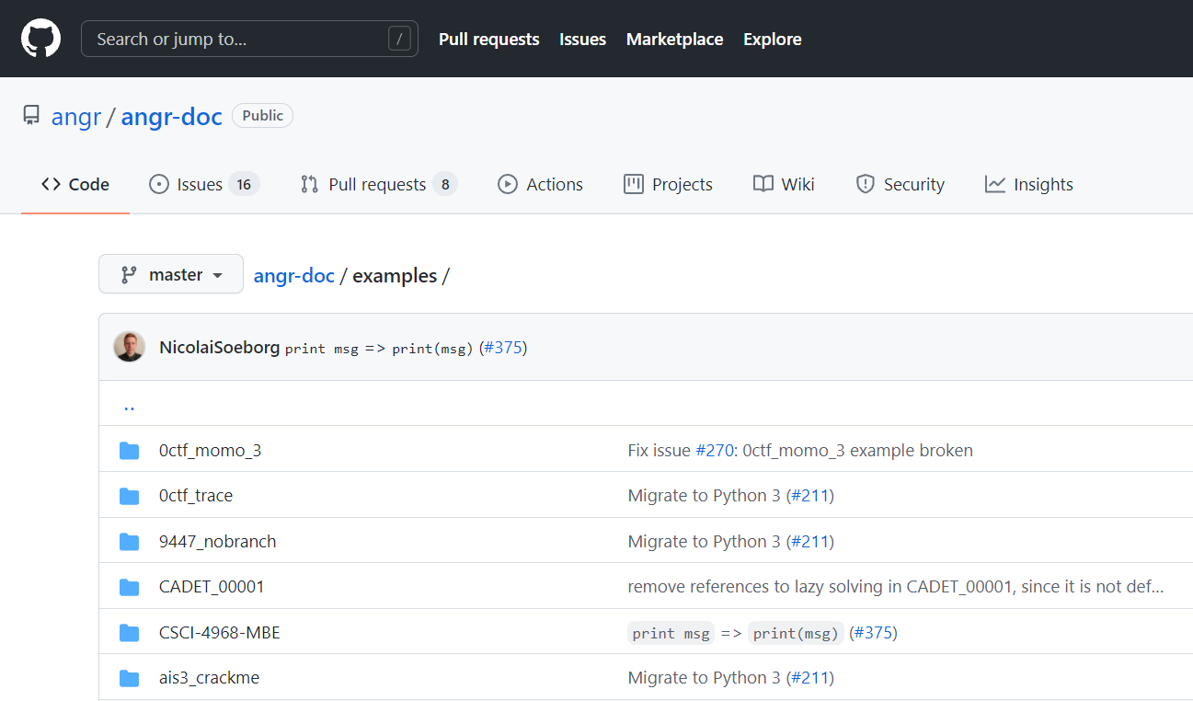
Angr-CTF
https://github.com/angr/angr-doc/tree/master/examples

Slide 34
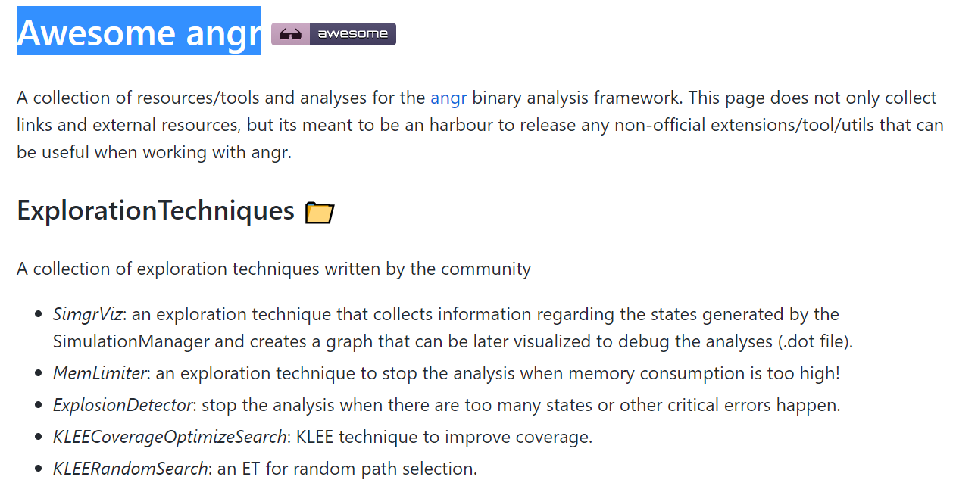
Awesome angr
https://github.com/degrigis/awesome-angr

Slide 35
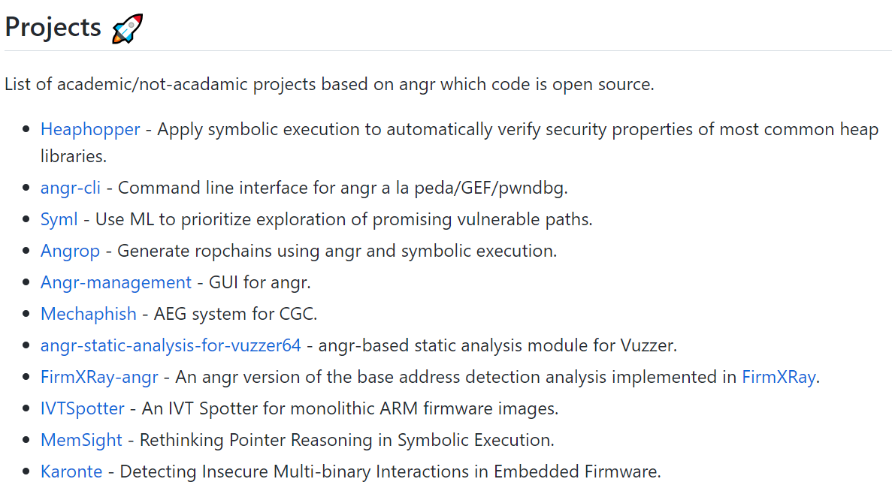
https://github.com/degrigis/awesome-angr

Slide 36
練習

Slide 37
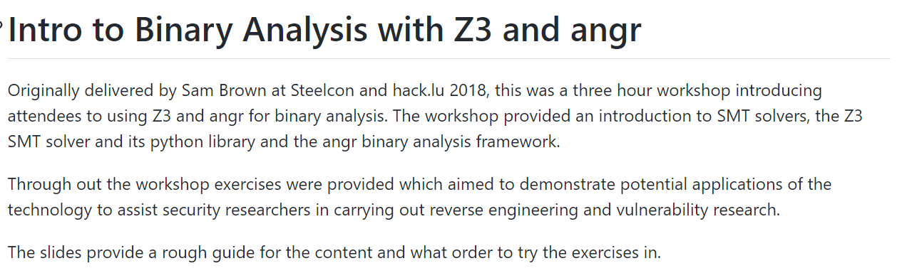
https://github.com/FSecureLABS/z3_and_angr_binary_analysis_workshop

Slide 38
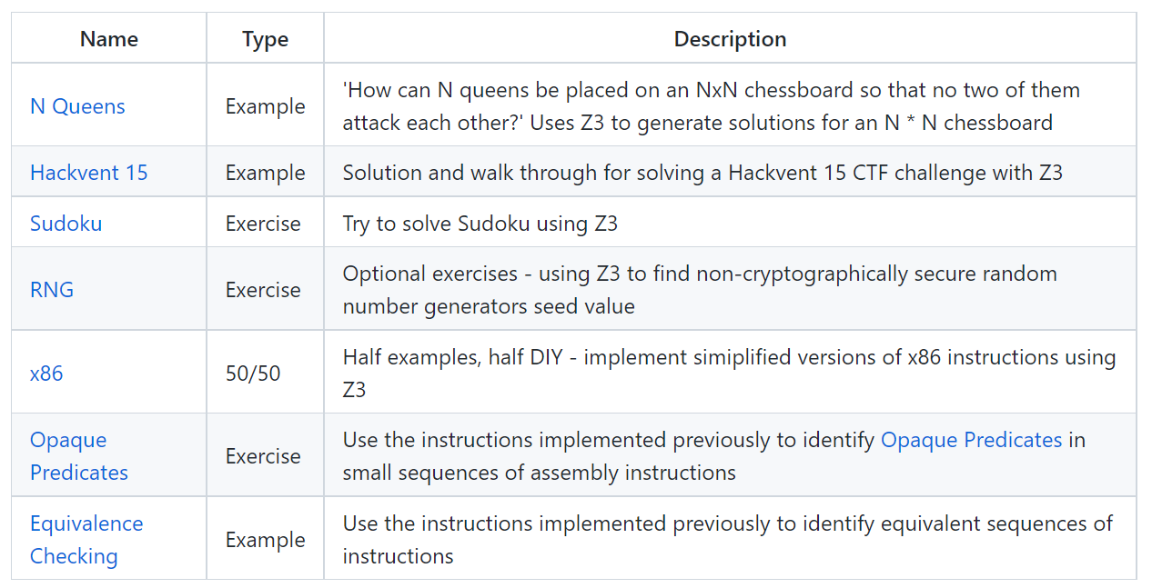
z3

Slide 39
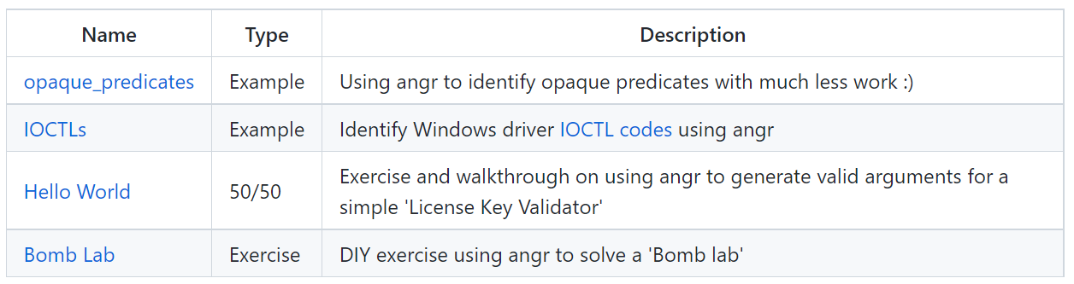
angr

